Slide 1
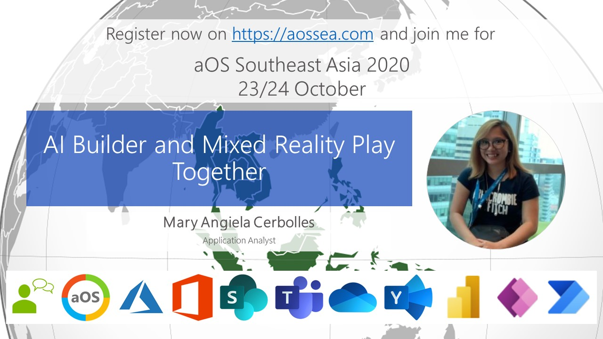

Slide 3
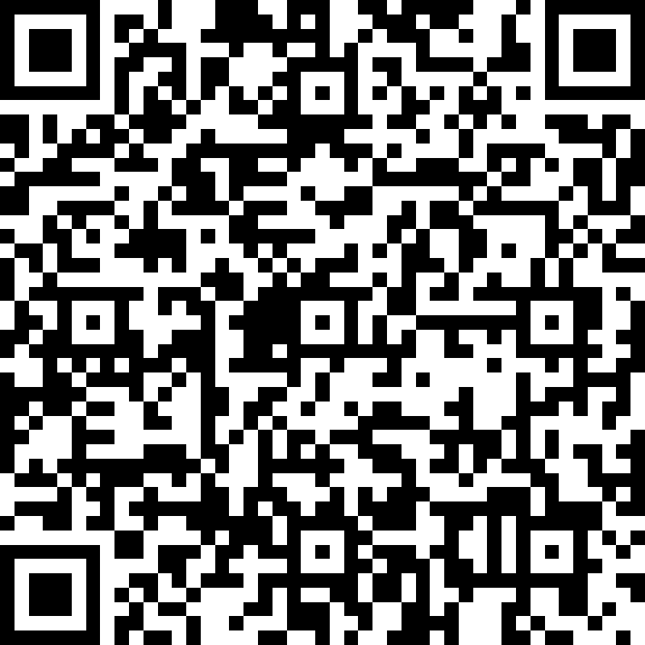
Join the aOS Quiz !
Attend the aOS sessions for 2 days
Answer as many questions as you can
Highest scorers get rewarded!
Throughout the 2 days aOS sessions, we will share this QR code with you
to participate on a quiz to win some prizes.
Answers can be found in every speaker’s session.
Submit your quiz latest by 11.59pm on the 24th Oct 2020.

Slide 4
AI Builder and Mixed Reality Play Together
By: Mary Angiela Cerbolles

Slide 5
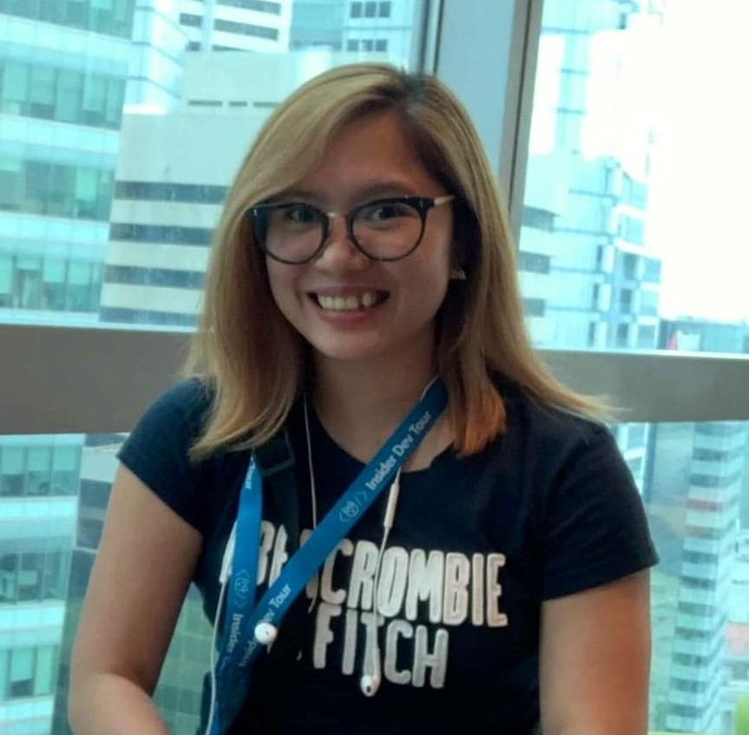


About Me
Collaboration Application Analyst focused on Microsoft SharePoint and Power Platform (Power Apps & Power Automate)
Humans of IT Ambassador
Microsoft MVP in Business Application
Mary Angiela “Anj” Cerbolles
Twitter: @anjcerbolles
Blog: anjcerbolles.net
LinkedIn: https://www.linkedin.com/in/maryangielacerbolles/

Slide 6
Agenda
AI Builder and Mixed Reality in Power Apps
Requirements
How we can integrate AI Builder and Mixed Reality in Power Apps
Let’s Build

Slide 7
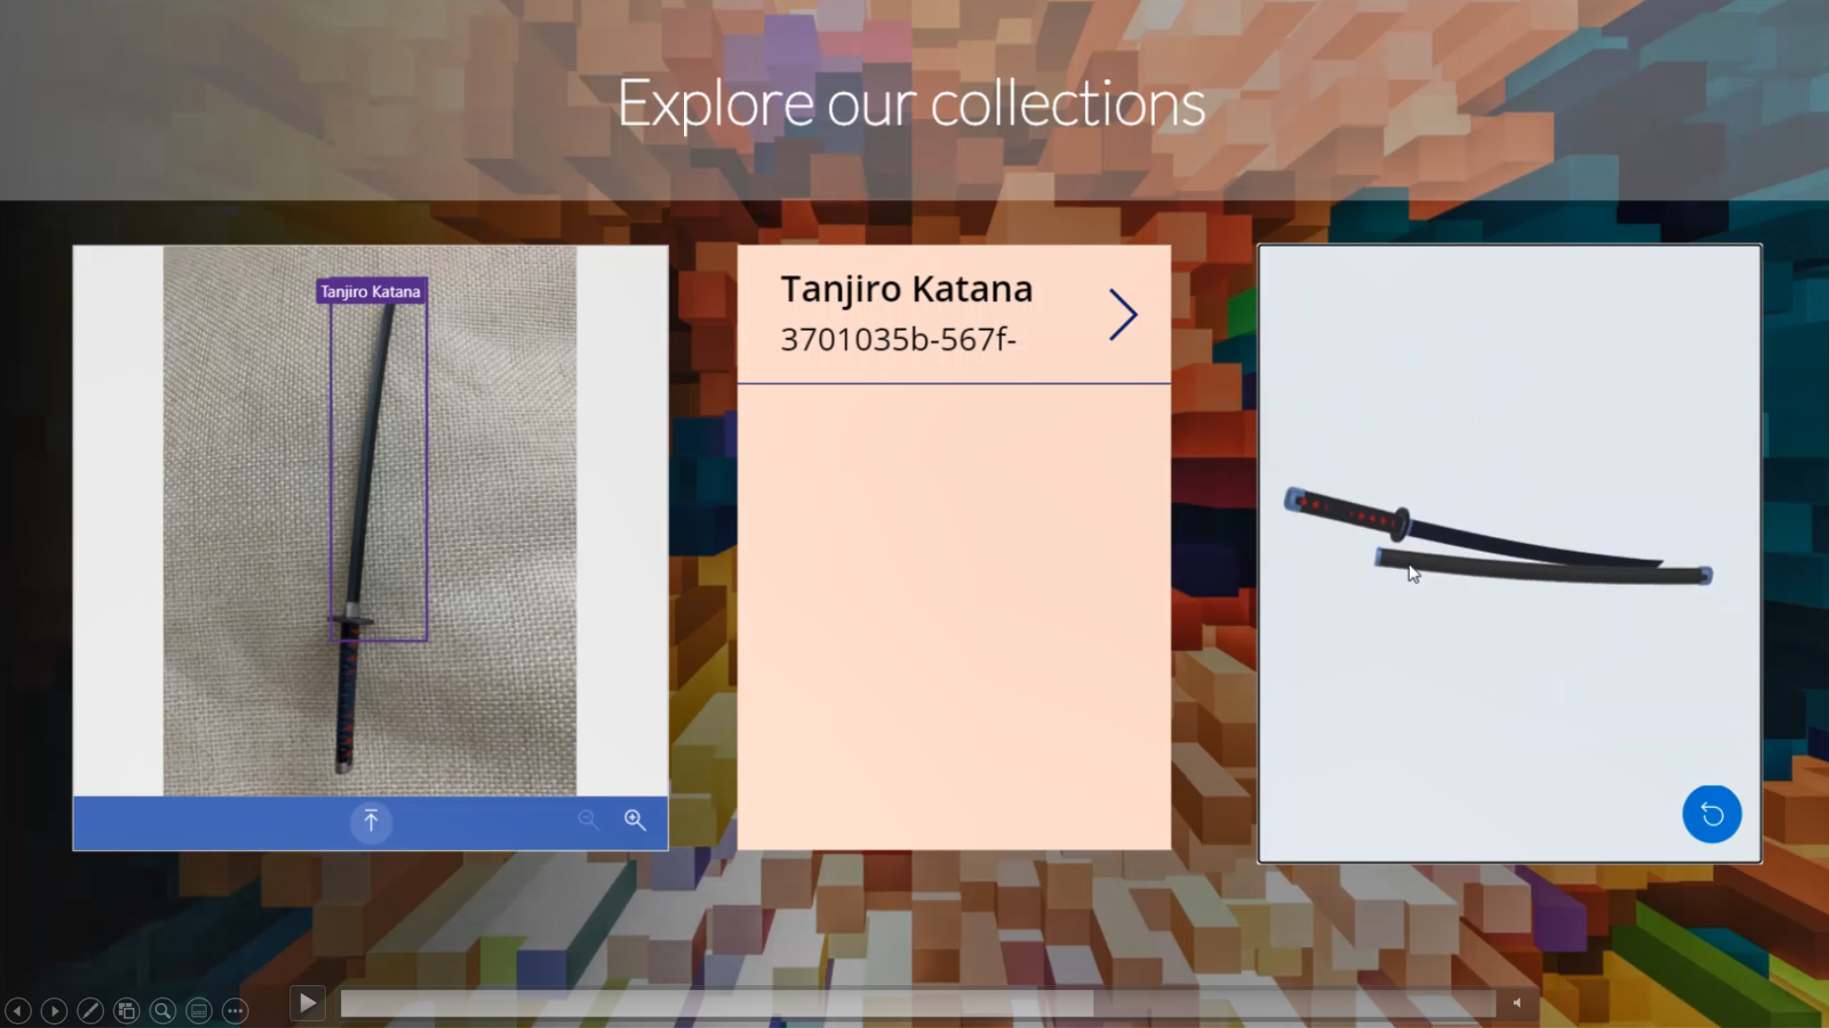

Slide 8
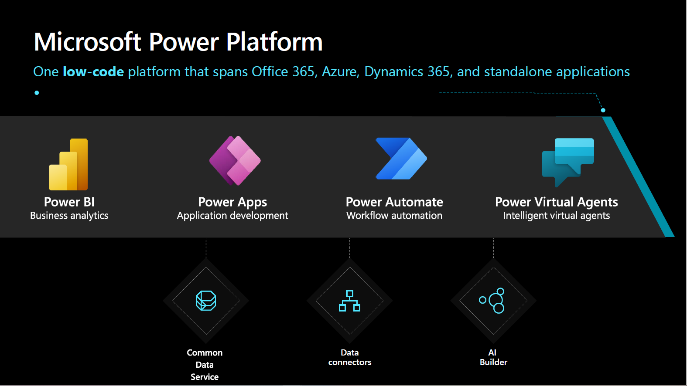

Slide 9

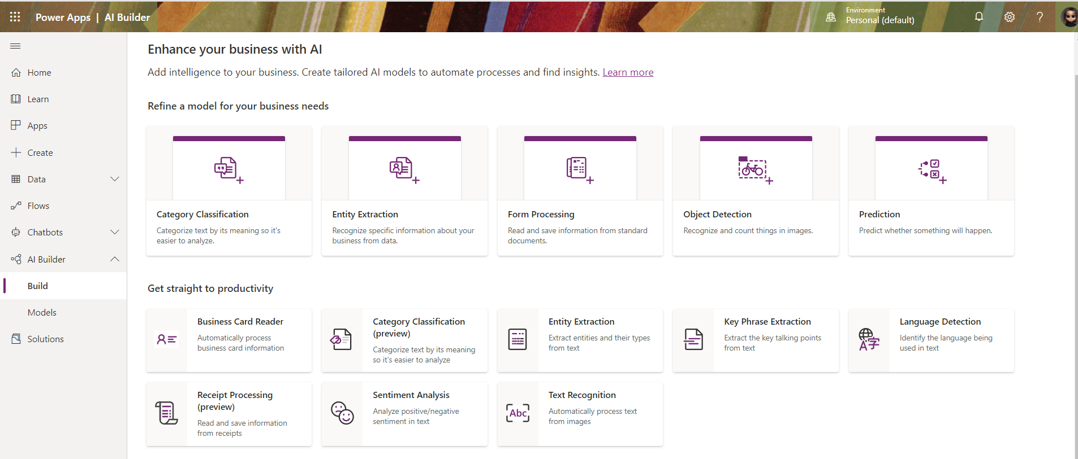
AI Builder

Slide 10
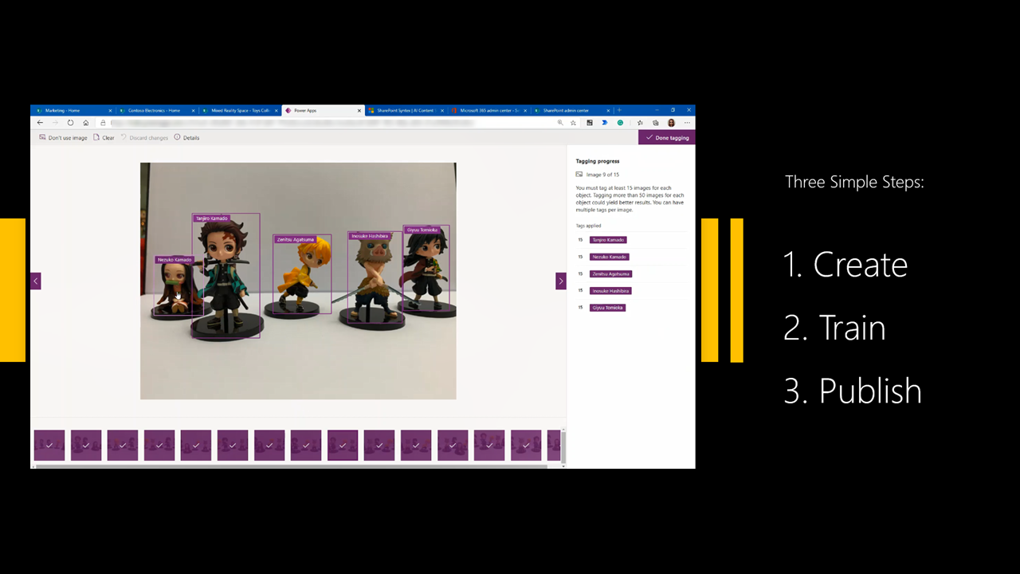

Slide 11
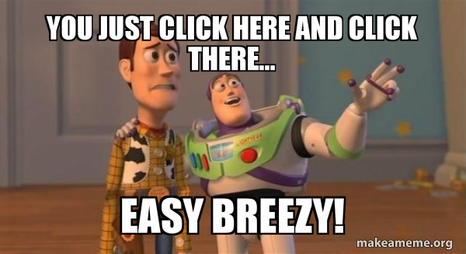

Slide 12
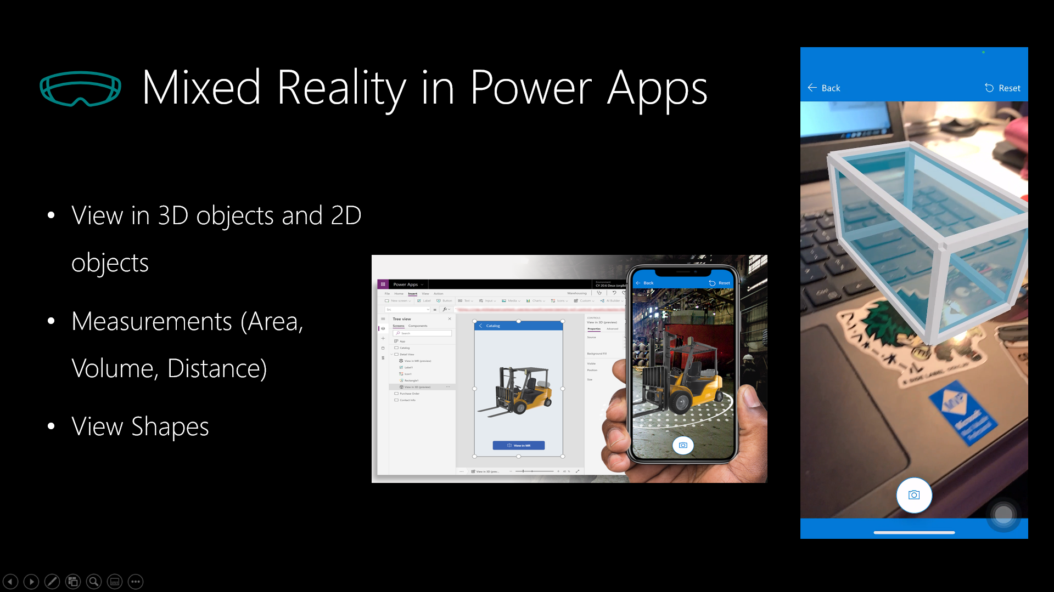

Slide 13
20% - currently in production or deploying Mixed Reality
67% - currently exploring use cases or piloting Mixed Reality
87%
* Source: Harvard Business Review Analytic Services Survey, March 2018

Slide 14

Business Scenario Requirements

Slide 15
Requirements:
Object Detection Model – AI Builder
15 images minimum
.GLB File for the 3D object
SharePoint List - store our data
Enable Mixed Reality Features in Power Apps

Slide 16
Let’s Build

Slide 17
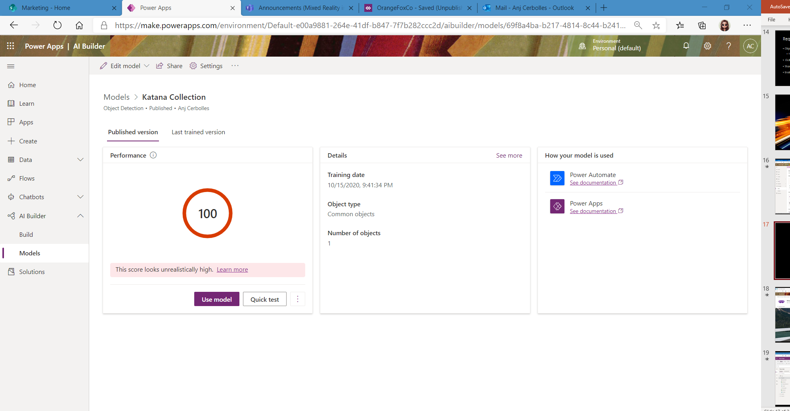
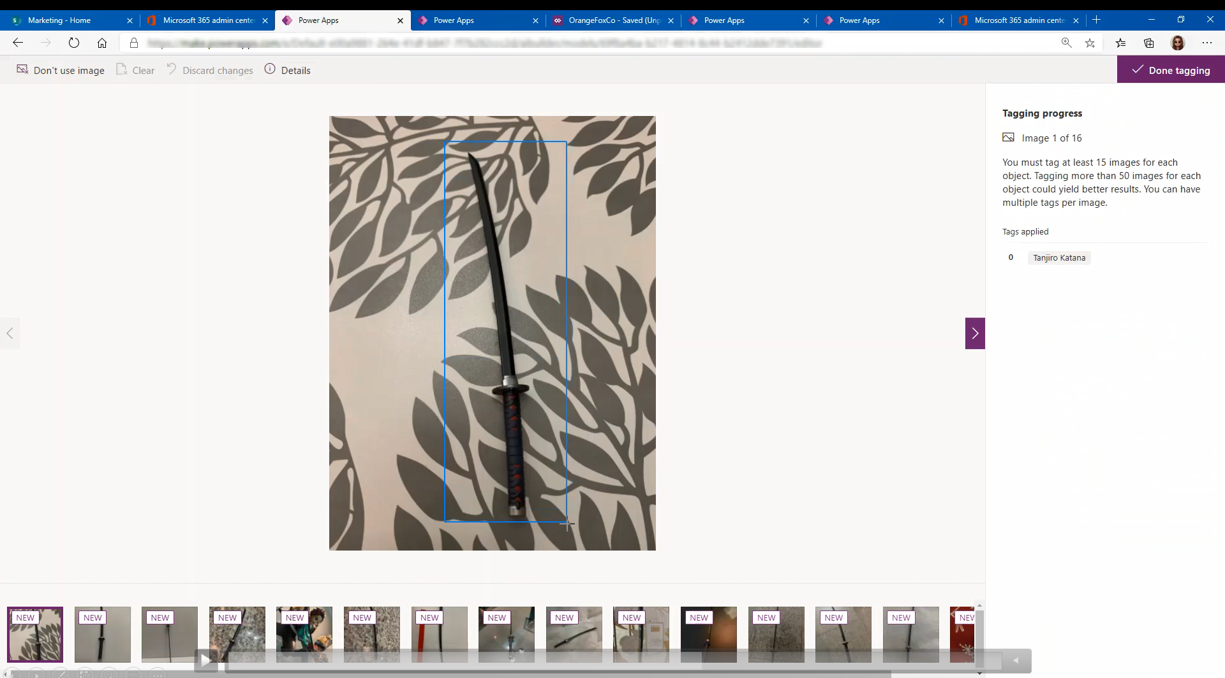

Slide 18
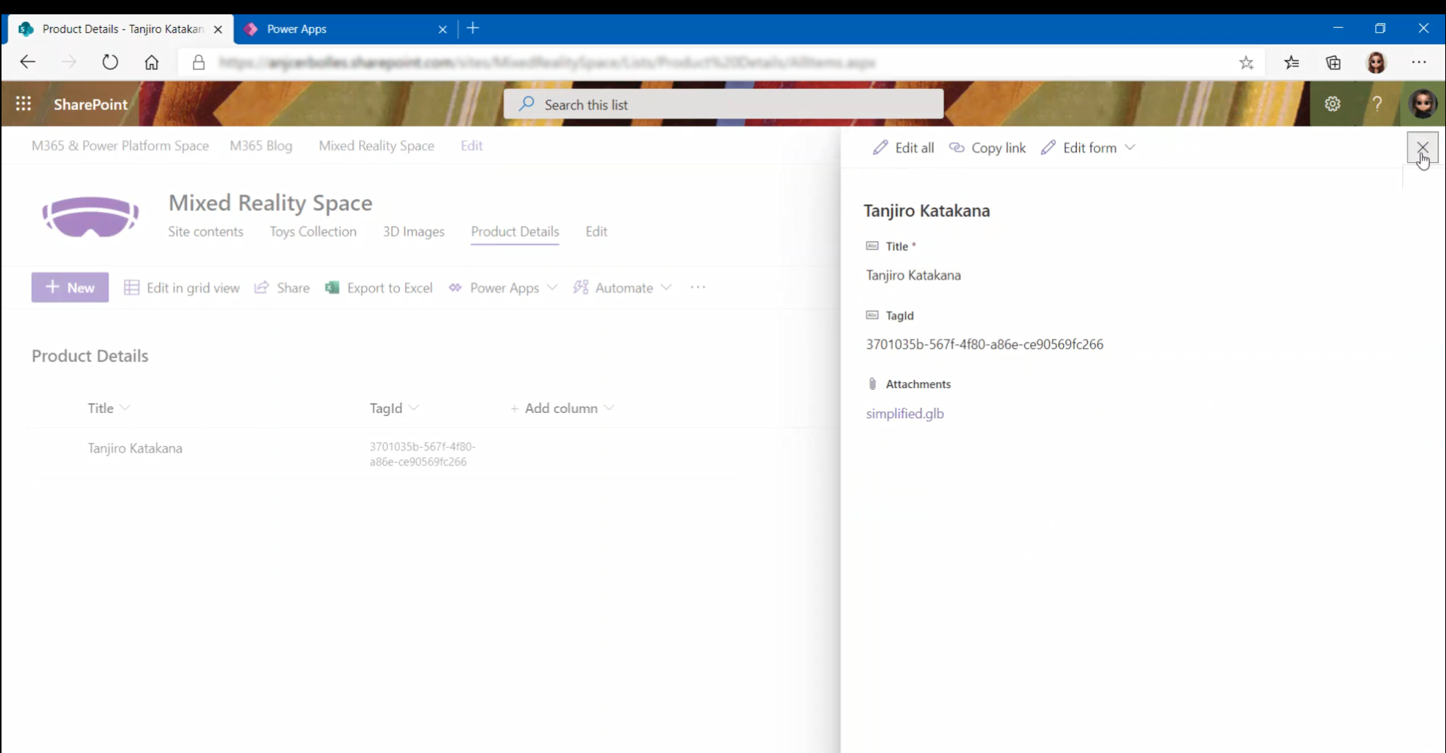

Slide 19
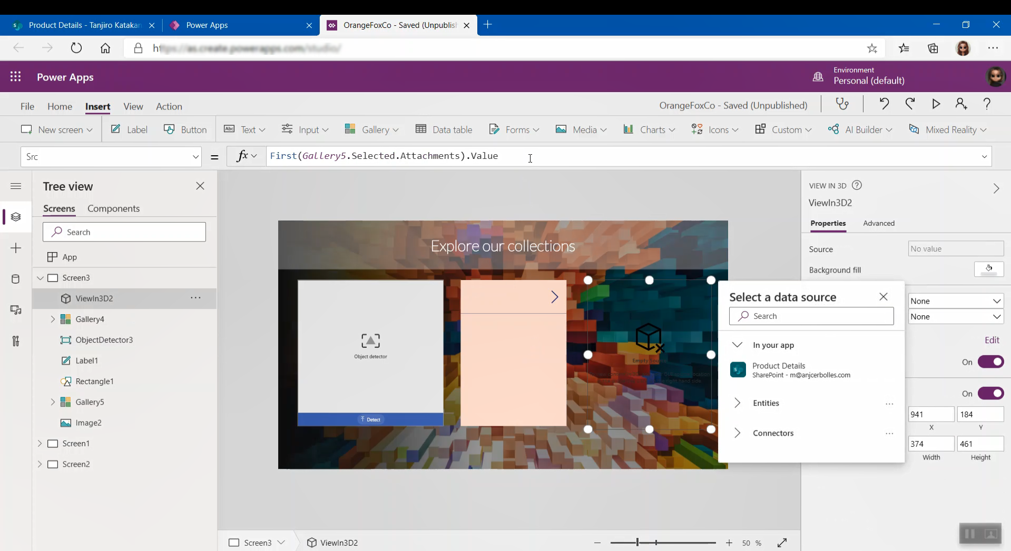

Slide 20
Reference:
Add Mixed Reality Components in Canvas App
https://docs.microsoft.com/en-us/powerapps/maker/canvas-apps/mixed-reality-overview
Power Apps Ideas Forum
https://aka.ms/powerAppsMRIdeas
AI Builder
https://docs.microsoft.com/en-us/ai-builder/
#PowerAddicts #FlowFam in Twitter

Slide 21
Day 2 Agenda – AM sessions
Time | Business | Developer | IT Pro
9:00 AM | AI Builder and Mixed Reality Play Together | Handling Change Notifications with Microsoft Graph | AI for All - with Azure Cognitive Services
 | Mary Angiela Cerbolles | Nanddeep Nachan Smita Nachan | Manonmani V S
10:00 AM | Deliver a better User Adoption for Microsoft Teams using Power Automate | Resource Specific Consent in Microsoft Teams Graph API | Robotic Process Automation in Power Automate
 | Jeevarajan Kumar Dharanidharan Balasubramaniam | NarasimaPerumal Chandramohan Vinodha Muthu Valli | Prabhath Mannapperuma
11:00 AM | Don't write off SharePoint just yet! | Microsoft Graph Toolkit - Simple, yet Powerful | Meeting In Microsoft Teams
 | Rico Ho | Hansamali Gamage | ZARNI TYN

Slide 22
Day 2 Agenda – PM sessions
Time | Business | Developer | IT Pro
1:00 PM | Enablement flows, Power Automate for M365 | Integrate your apps with Azure Blockchain using Power Apps & Microsoft Flow | How secure is your endpoint protection?
 | Yawer Iqbal | Asif Waquar | Sabrina Kay
2:00 PM | Build a Policy Management System using Microsoft 365 Apps | SPFx CI/CD using GitHub Actions | Intelligent communications in Microsoft Teams
 | Jag Kakarlapudi | Aakash Bhardwaj | Vignesh Ganesan Vijai Anand Ramalingam
3:00 PM | Why Power Platform? | Use Azure Functions to implement Site Design for SharePoint SubSites | Cortex and Syntex : Digitalize your company information
 | Leo Kyaw | Jayakumar Balasubramaniam | Sébastien PAULET Patrick Guimonet

Slide 23
Join the aOS Quiz !
Attend the aOS sessions for 2 days
Answer as many questions as you can
Highest scorers get rewarded!
Scan for
Feedback & Quiz
Throughout the 2 days aOS sessions, we will share this QR code with you
to participate on a quiz to win some prizes.
Answers can be found in every speaker’s session.
Submit your quiz latest by 11.59pm on the 24th Oct 2020.

Slide 24
Thank You

